Slide 1
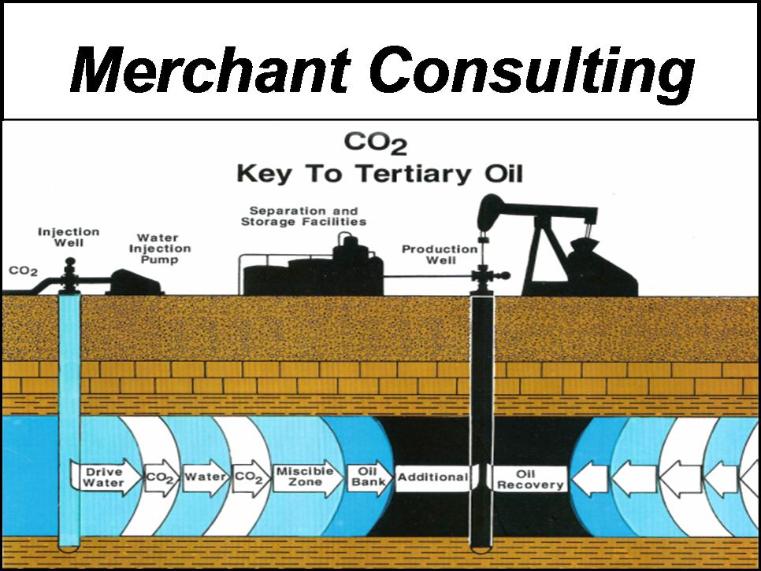


Gulf Coast Scoping Model Development
CO₂ Plume Scoping Model
David H. Merchant
Scoping Model CO₂ Plume Development
March 2023 Introduction

Slide 2
Why is the Gulf Coast Region a “Great Place” to Understand CO₂ Plume Injection?
Are Scoping Model Techniques the Answer to better understand Plume Expansion over time?

Slide 3
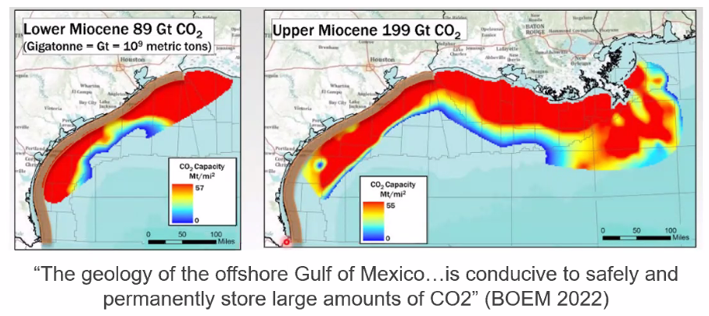
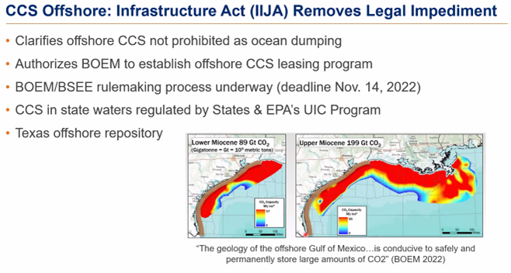
Gulf Coast CO₂ Storage Potential
Storage Capacity
Reservoir Understanding

Slide 4
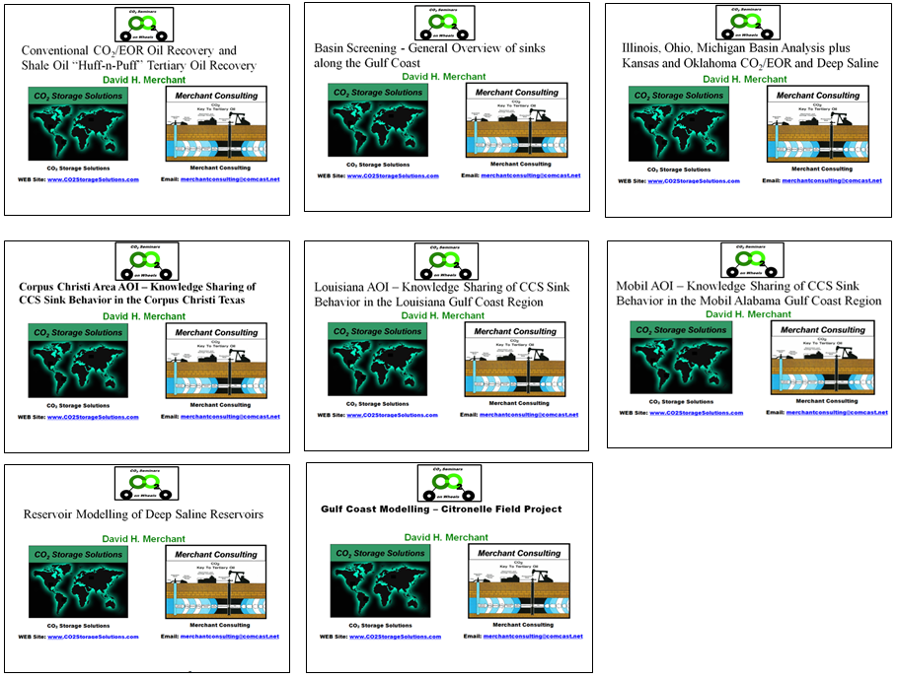
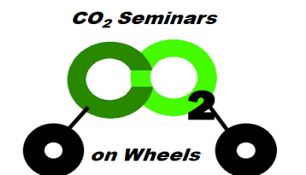
In 2022, Merchant Consulting taught a “SeminarsOnWheels” Four Day Course to a “Deep Saline Startup Company” targeting United States Basin Screening, CO₂/EOR, and Deep Saline Injection

Slide 5
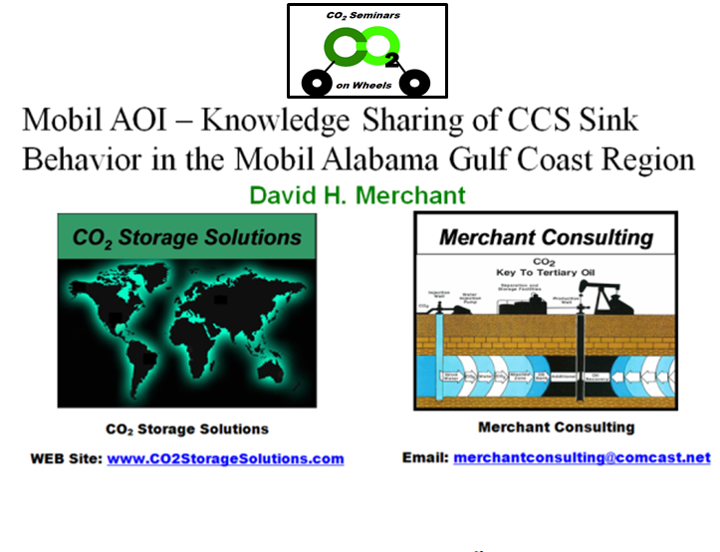
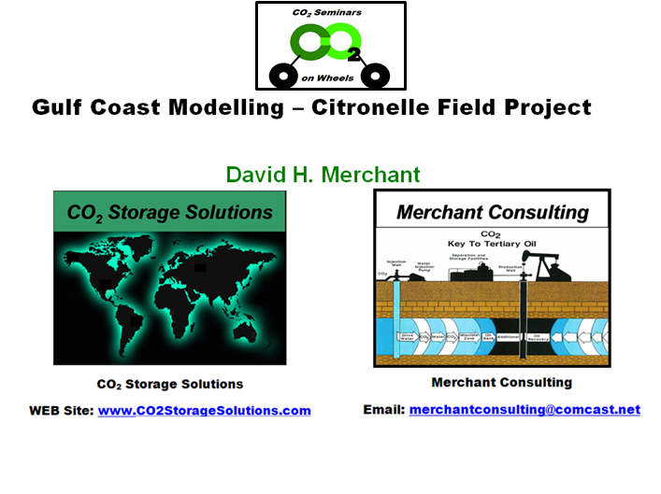
In preparing for the “Mobil Alabama AOI” Class a “Plume Scoping Model” was developed from the “Actual Pilot Historical CO₂ Injection Plume Performance Data”
The Citronelle “Deep Saline Project” represents the “Best Reservoir Example” of an “Actual Deep Saline Pilot” run over a two year period injecting 114,000 Metric Tonnes of CO₂.

Slide 6
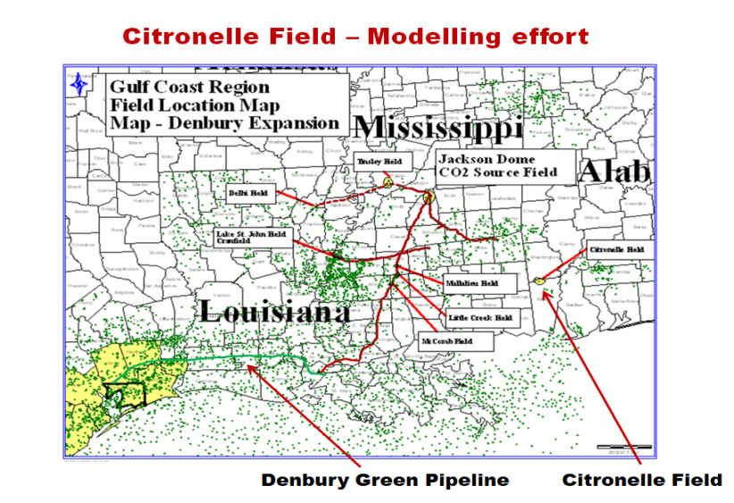
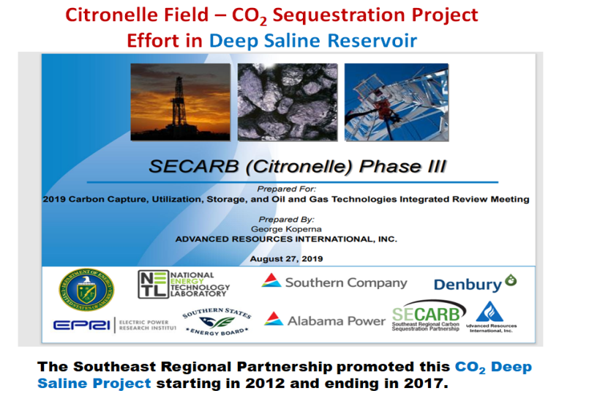
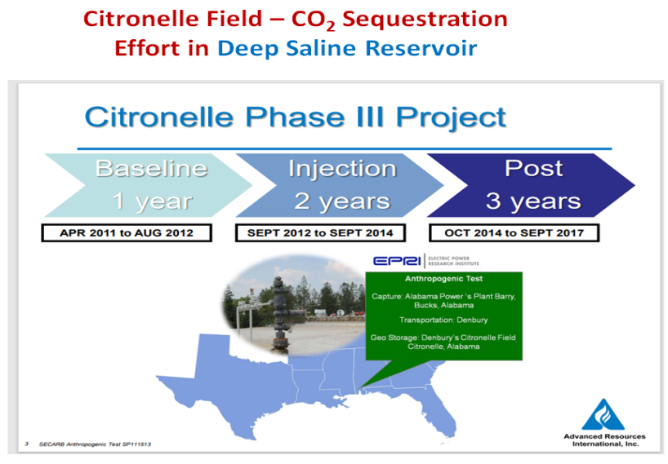
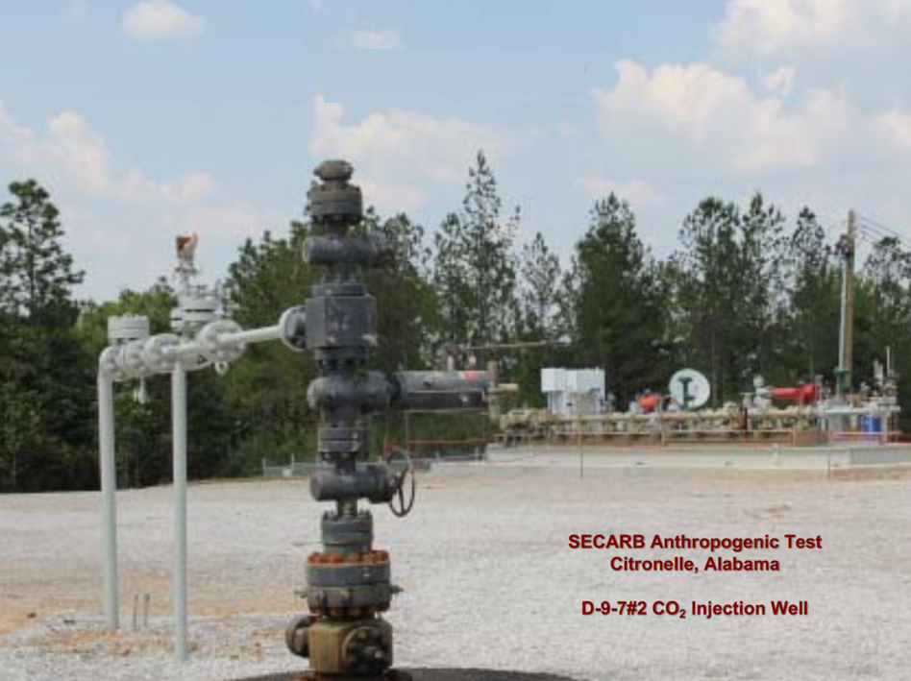
SECARB Clean Coal and Deep Saline Project
Citronelle Deep Saline CO₂ Capture Sequestration Project
The Citronelle CO₂ Sequestration Project started injecting CO₂ into Deep Saline Reservoirs in 2012 and ended the project in 2014.

Slide 7
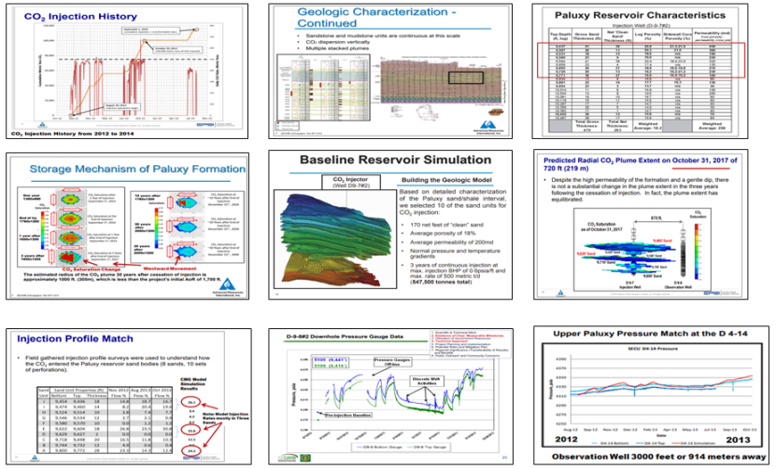
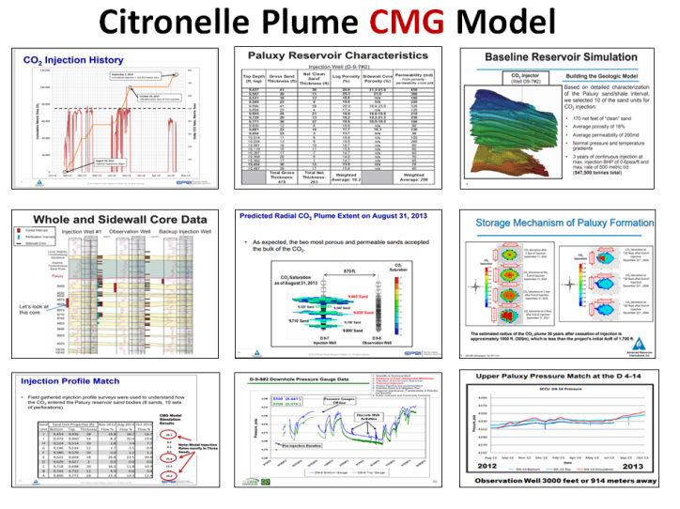
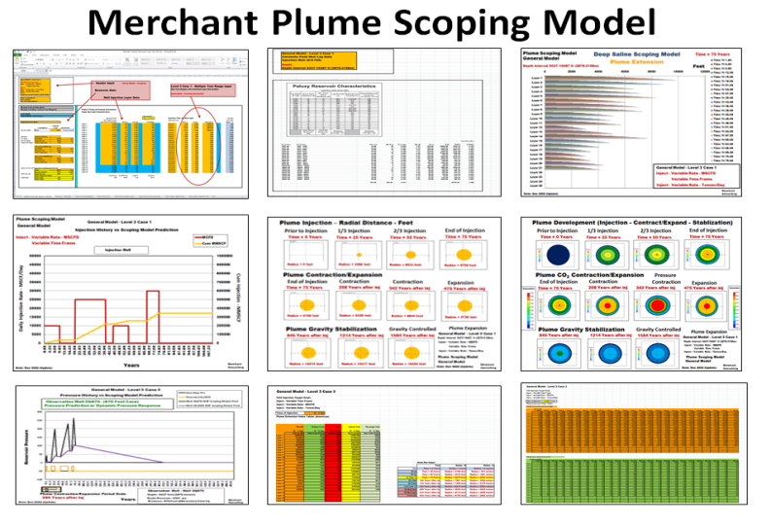
Citronelle Field - Alabama
Good Reservoir Model Development Characteristics
CMG
Model
Scoping
Model
Good Reservoir Data provided “Good History Match” Comparisons for Both CMG Reservoir Modelling and Scoping Model Development

Slide 8
What Level of Predictions can Scoping Models Today Provide?
(Simple to Complex)
Scoping Model Development

Slide 9
Output Examples
Output Examples of the Three Output Levels are shown on the next set of slides.
The Examples reflect “Scoping Model Output” with “Minimum Input”. As of January, 2023, the Current Version reflects the following areas listed below. Future Versions will Target “Injection Well Calculations” and more important “Addition of Walls”, which will modify “Dynamic Pressure Calculations” for “CO₂ Storage Capacity Determination”. Today’s Targets are listed below:
1. Injection Rate through Time (25 Layers with Variable Time Input)
2. Plume Areal Maximum Extent Calculations
3. Plume Layer Horizontal Extent Calculations
4. Two Observation Well Calculations (870 ft and 3000 ft) from Inj.
4. CO₂ Saturation Changes through Time
5. CO₂ Dynamic Pressure Calculation (Inj, Contr/Expnd, Stabilization)
6. CO₂ Output Tables for “Back-to-the-Reservoir” Plume Understanding and 3-d Visualization tied to Deep Saline Reservoir Geology
7. Metric Output Plots and Tables
Scoping Model Output Examples

Slide 10
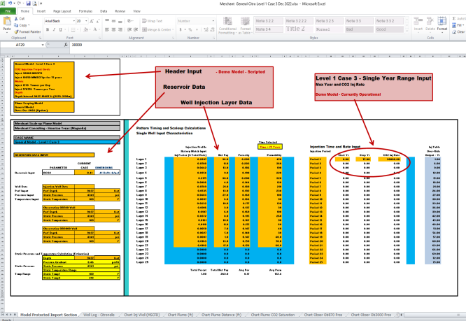
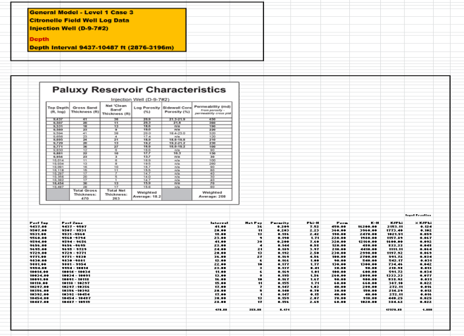
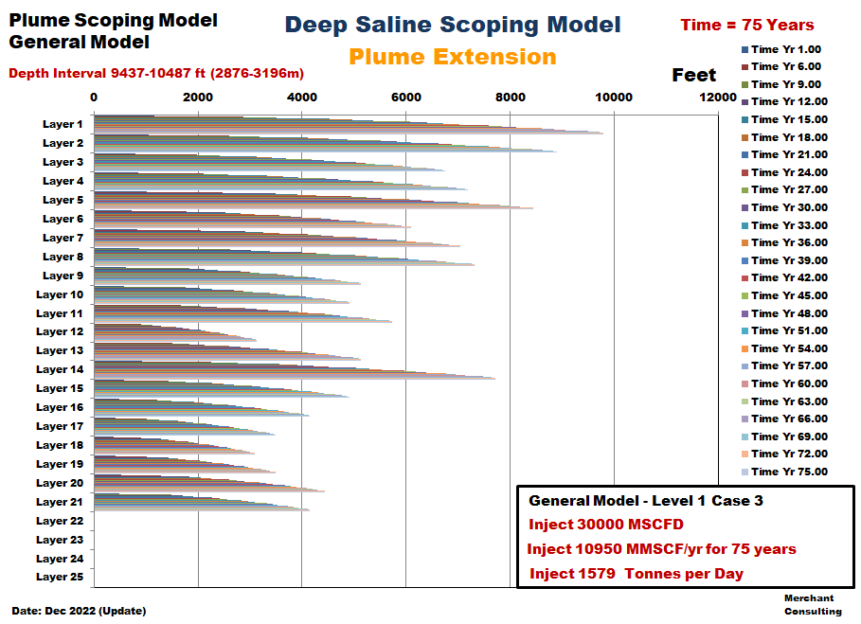
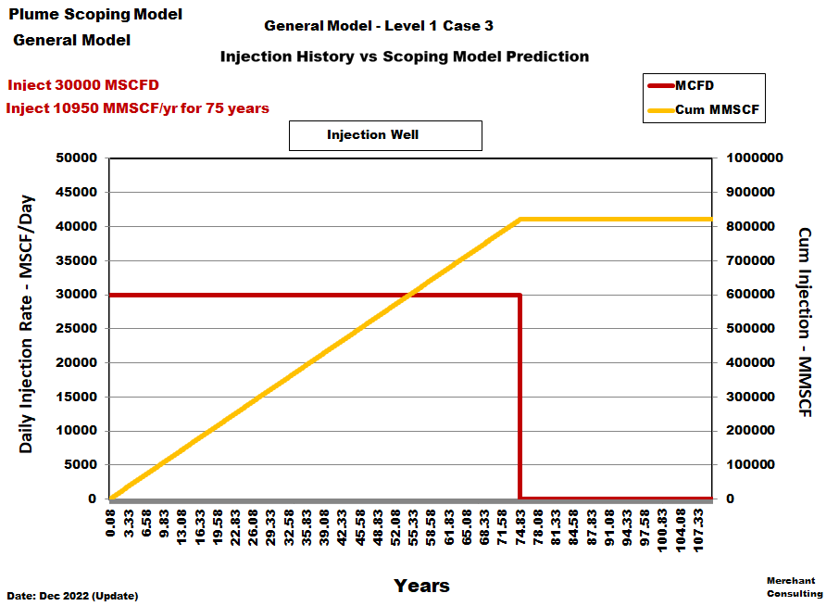
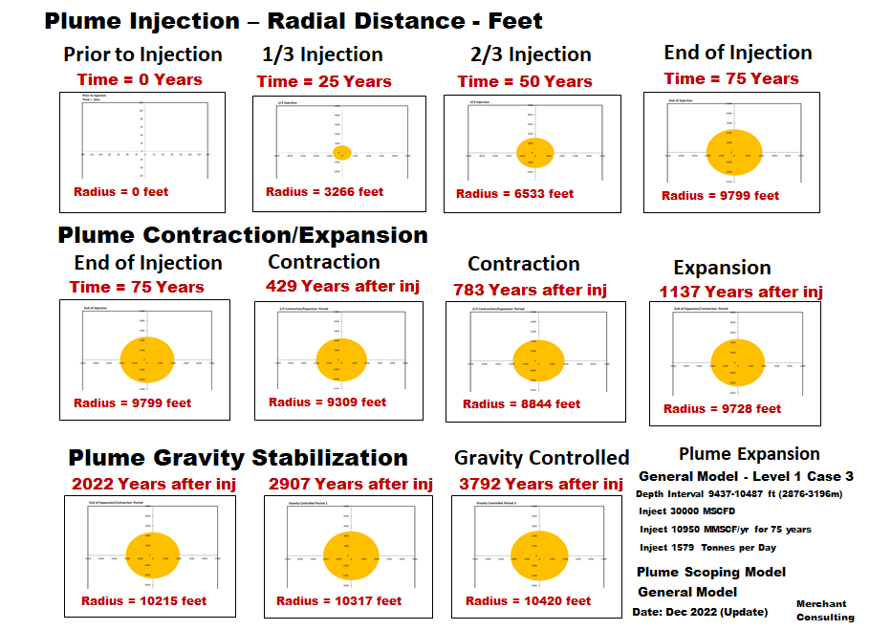
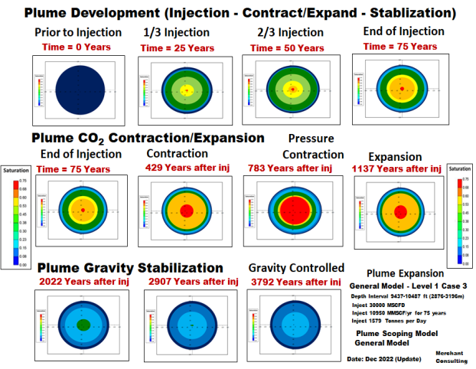
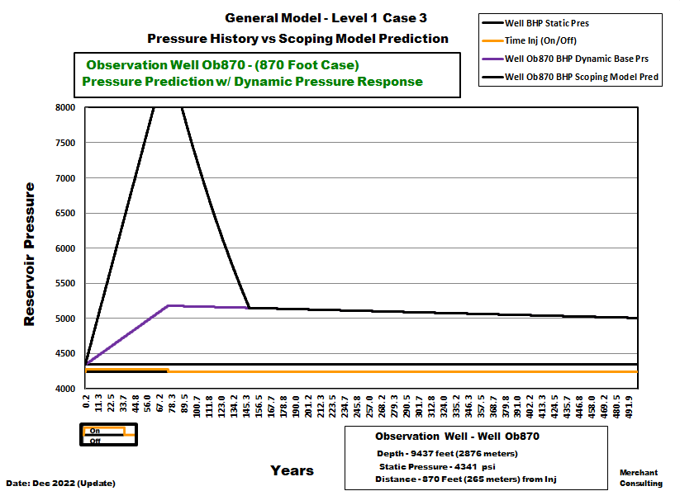
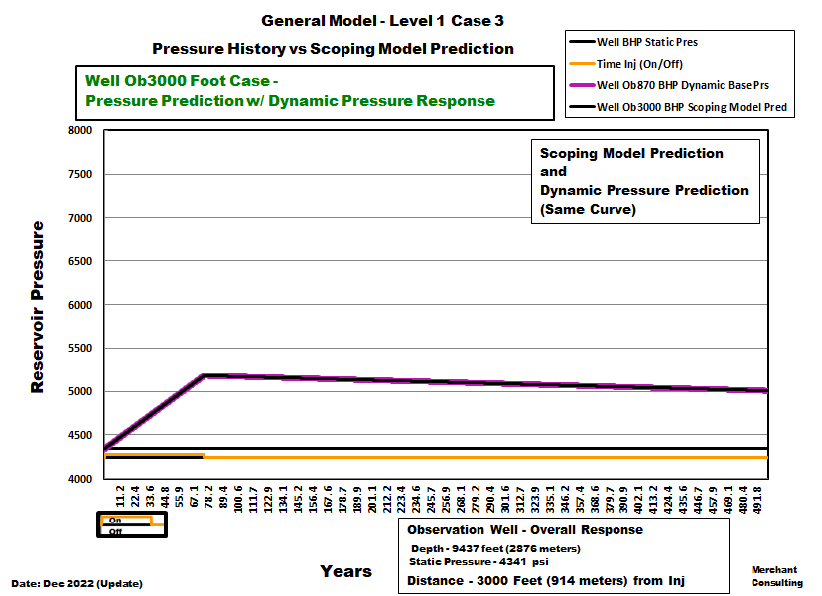
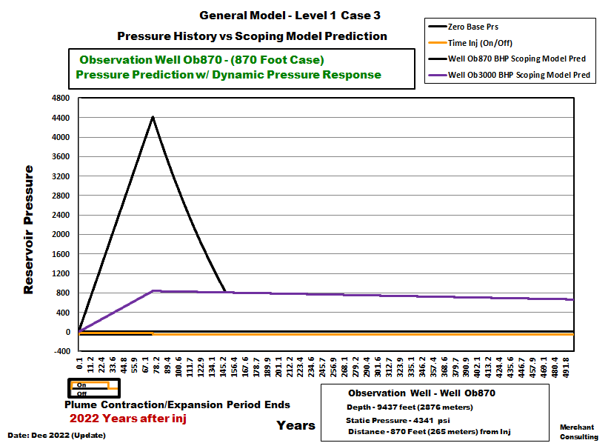
General Model - Level 1 Case 3
Example
Output

Slide 11
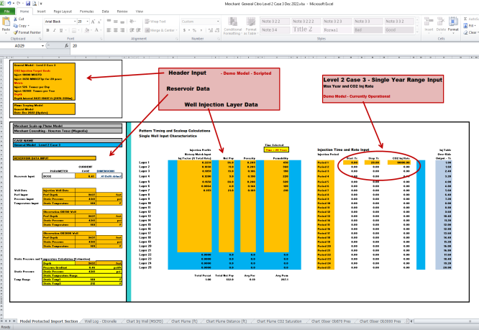
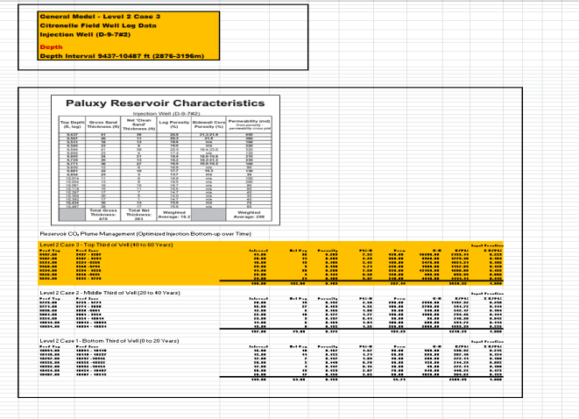
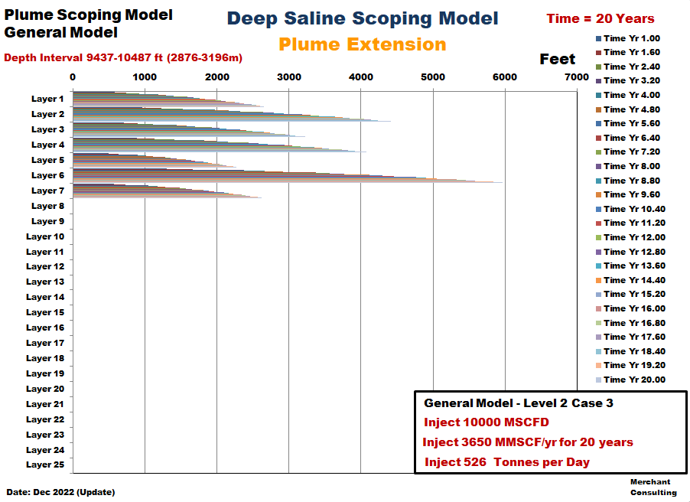
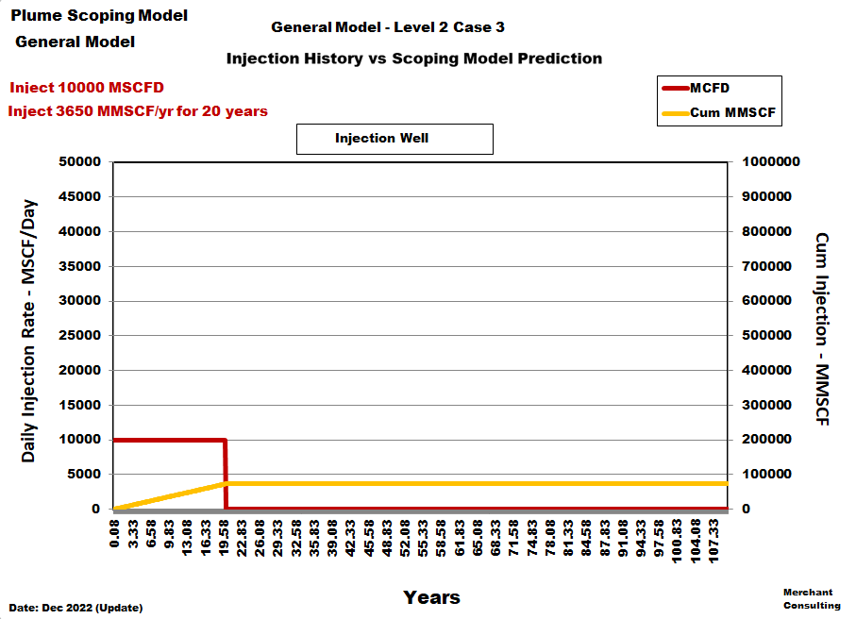
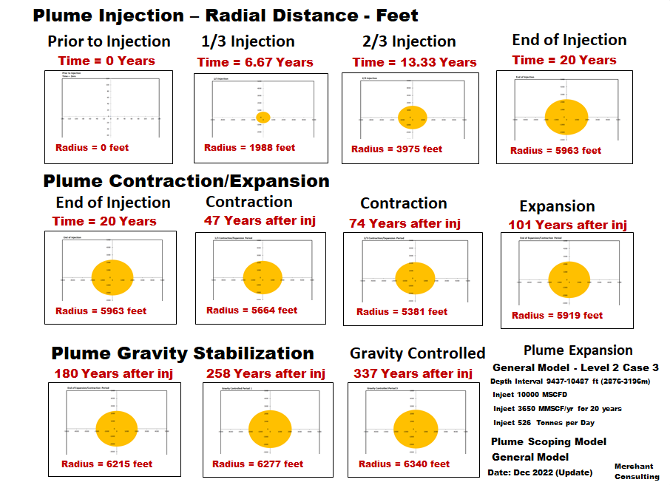
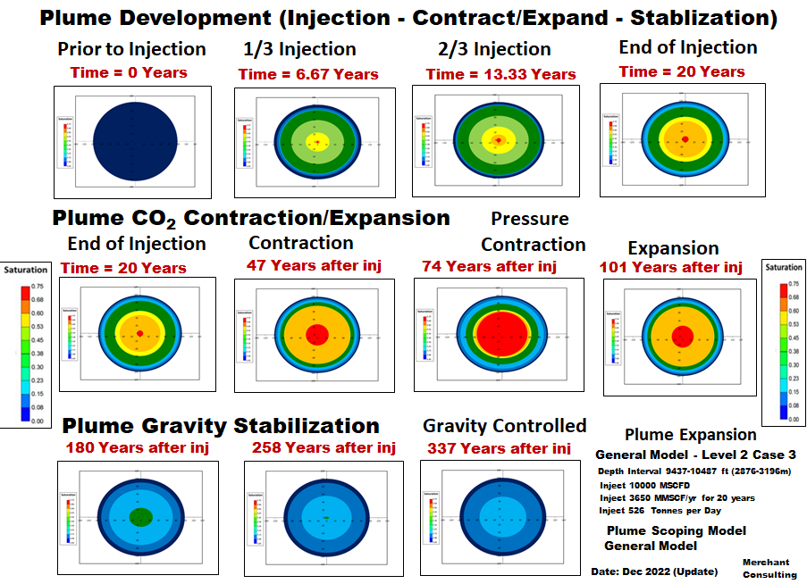
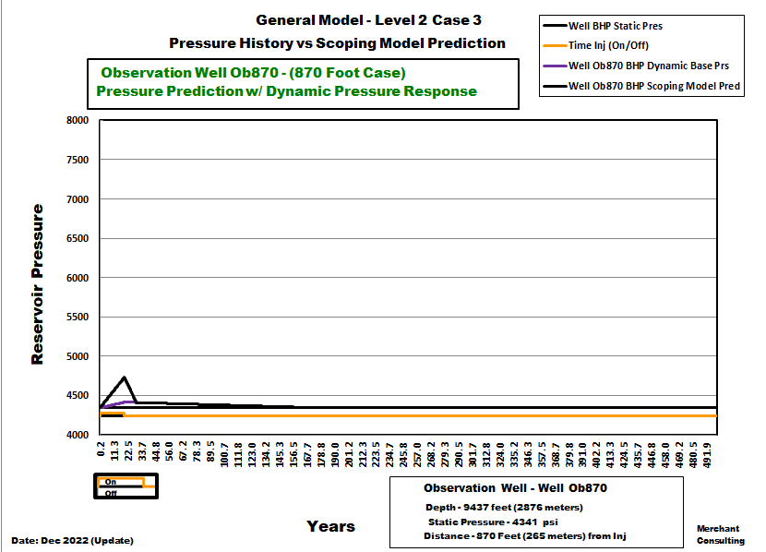
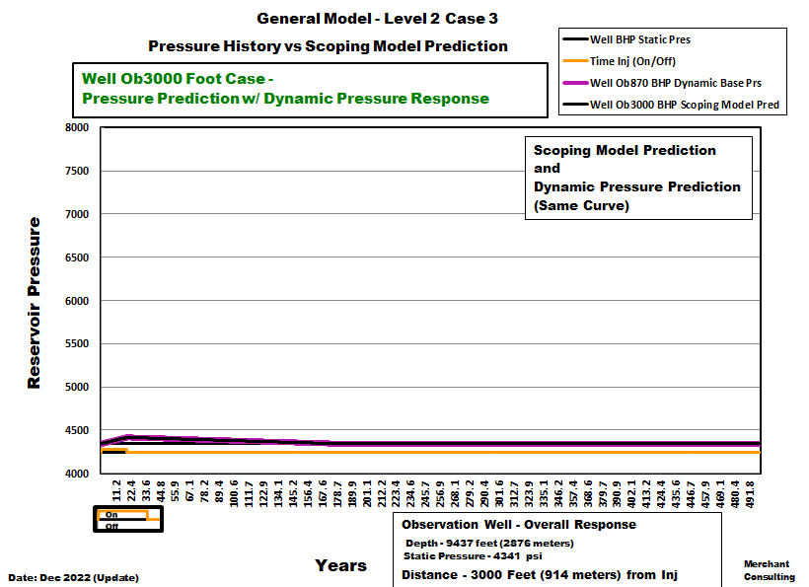
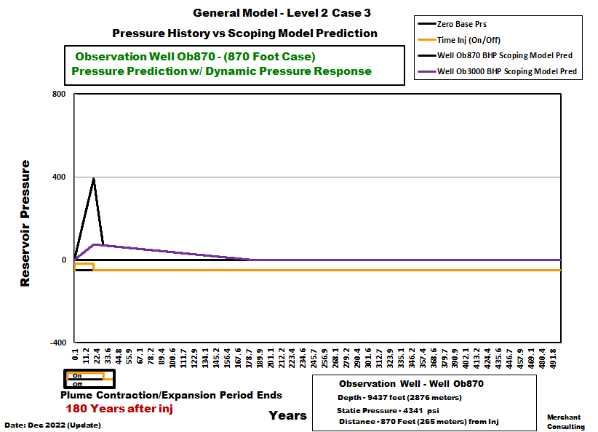
General Model - Level 2 Case 3
Example
Output

Slide 12
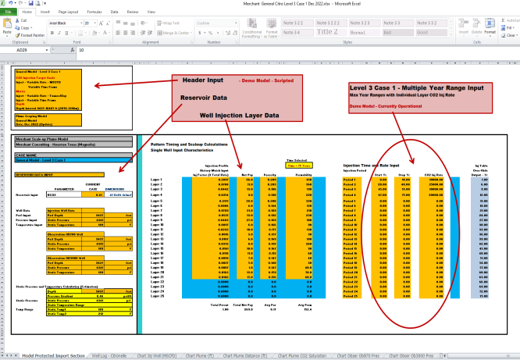
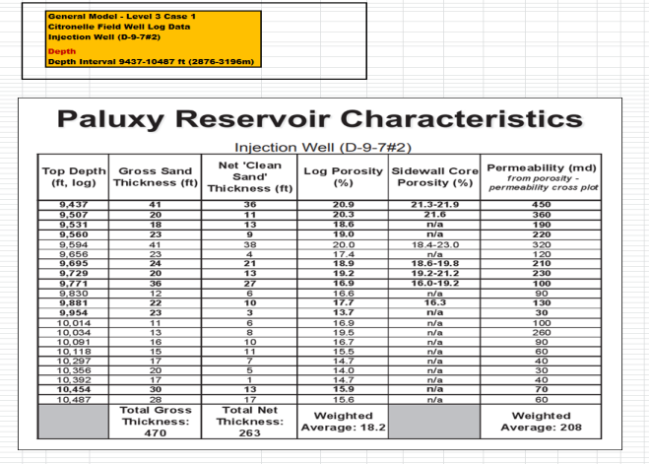
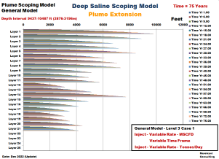
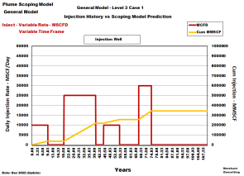
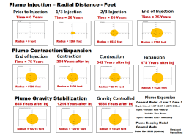

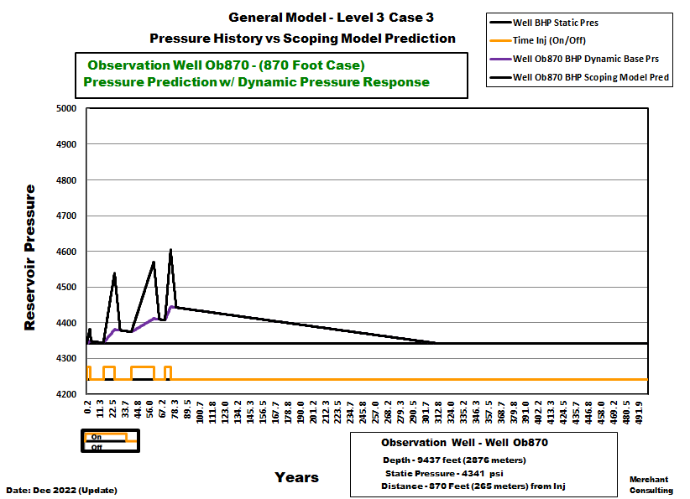
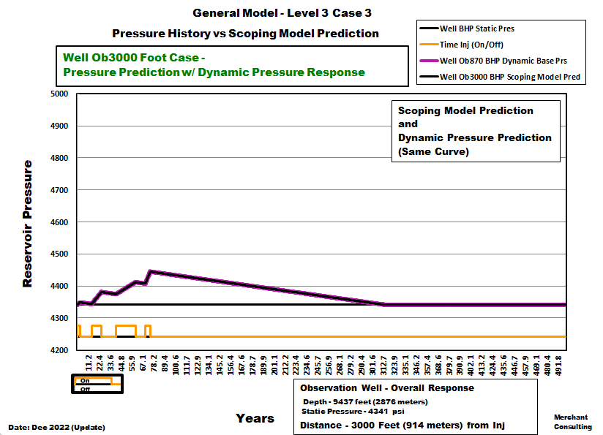
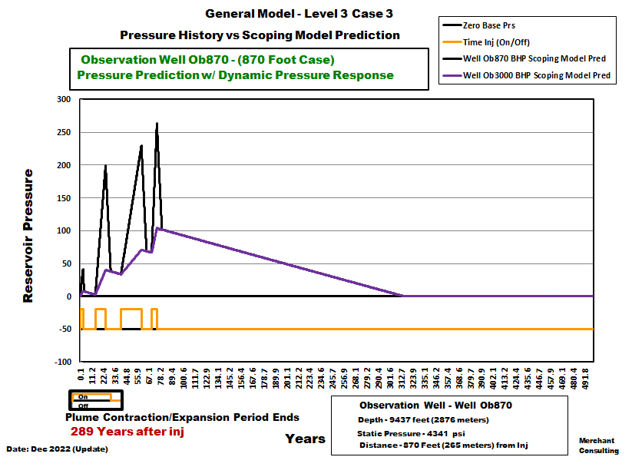
General Model - Level 3 Case 3
Example
Output

Slide 13
User Demo Files
Three Levels of Input levels are shown on the next set of slides including:
(Three-Demo-Examples) for Each Level.
You can Open each Case and change certain Variables to See for Yourself how changes effect:
1. Injection Rate through Time
2. Plume Areal Maximum Extent
3. Plume Layer Horizontal Extent
4. Two Observation Well Calculations (870 ft and 3000 ft)
5. Dynamic Pressure Response with Time
6. CO₂ Pressure (Inj, Contr/Expnd, Stabilization)
7. CO₂ Saturation Changes through Time
Scoping Model Demo Files

Slide 14
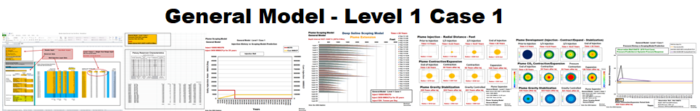
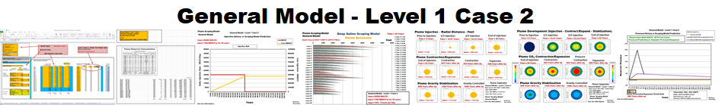
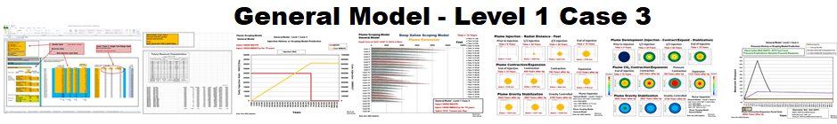
General Model - Level 1 Cases
Modifications: Constant Injection Rate and Time
(Baby Steps)
Level 1 Case 1
Level 1 Case 2
Level 1 Case 3

Slide 15
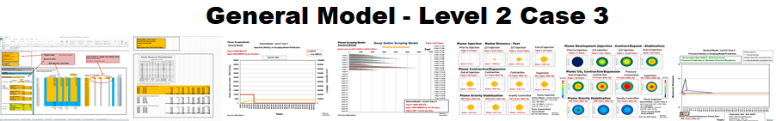
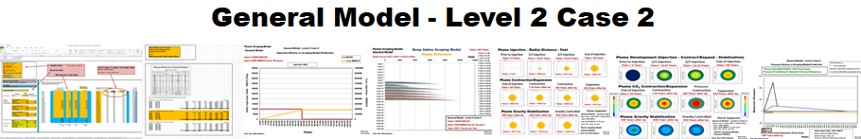
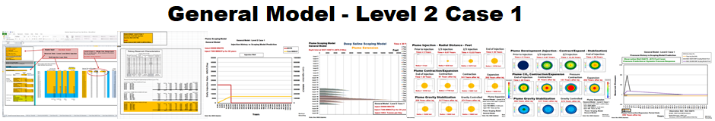
General Model - Level 2 Cases
Modifications: Variable Injection Rate and Time
With Bottom-up Layer Optimization through Time
Level 2 Case 3
Level 2 Case 2
Level 2 Case 1

Slide 16
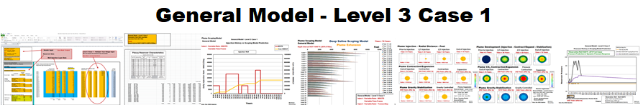
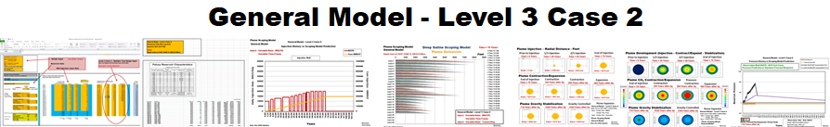
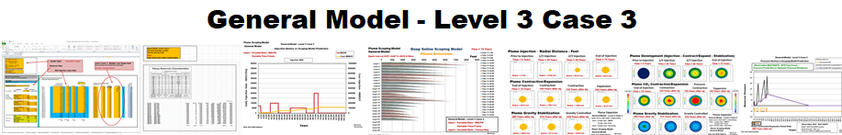
General Model - Level 3 Cases
Modifications: Variable Injection Rate and Time
Level 3 Case 1
Level 3 Case 2
Level 3 Case 3

Slide 17
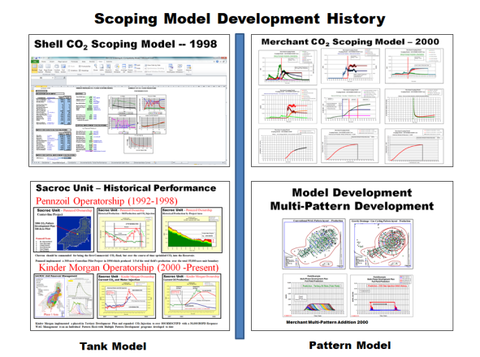

Scoping Model Techniques
Merchant Consulting has successfully provided Company Clients both “Reservoir Simulation Results” (Eclipse300, VIP, GEM, MORE, Amoco’s GCOMP Model), along with “CO₂/EOR Scoping Model Predictions” for Enhanced Oil Recovery Evaluations for over 24 years across the United States. Today, that technology expands into the CO₂ Plume World.
Scoping Model Techniques are in “No way” a replacement for Reservoir Plume Modelling; but, do provide a “Visual Pathway” to understanding “CO₂ Plume Behavior” without the Time and Cost of Reservoir Simulation.
For those interested in further understanding “CO₂ Plume Behavior” please contact me at:
Email: merchantconsulting@comcast.net
Phone: 281-686-6320
WEB: www.CO2StorageSolutions.com
WEB: www.CO2SeminarsOnWheels.com
Scoping Model versus Reservoir Modelling

